Slide 1

Course Name: C-Programming
Course Seminar on
“C-Programming”
Class - 0
Course In-charge: Prof. Vivek Deshmukh

Slide 2

WHY YOU SHOULD
LEARN C?
Very fast in terms of execution.
It is Procedure Oriented.
Mid level language.
C is bare-bone programming language.
Easy logic building.

Slide 3
ARE YOU MAKING
THESE MISTAKES?

Slide 4
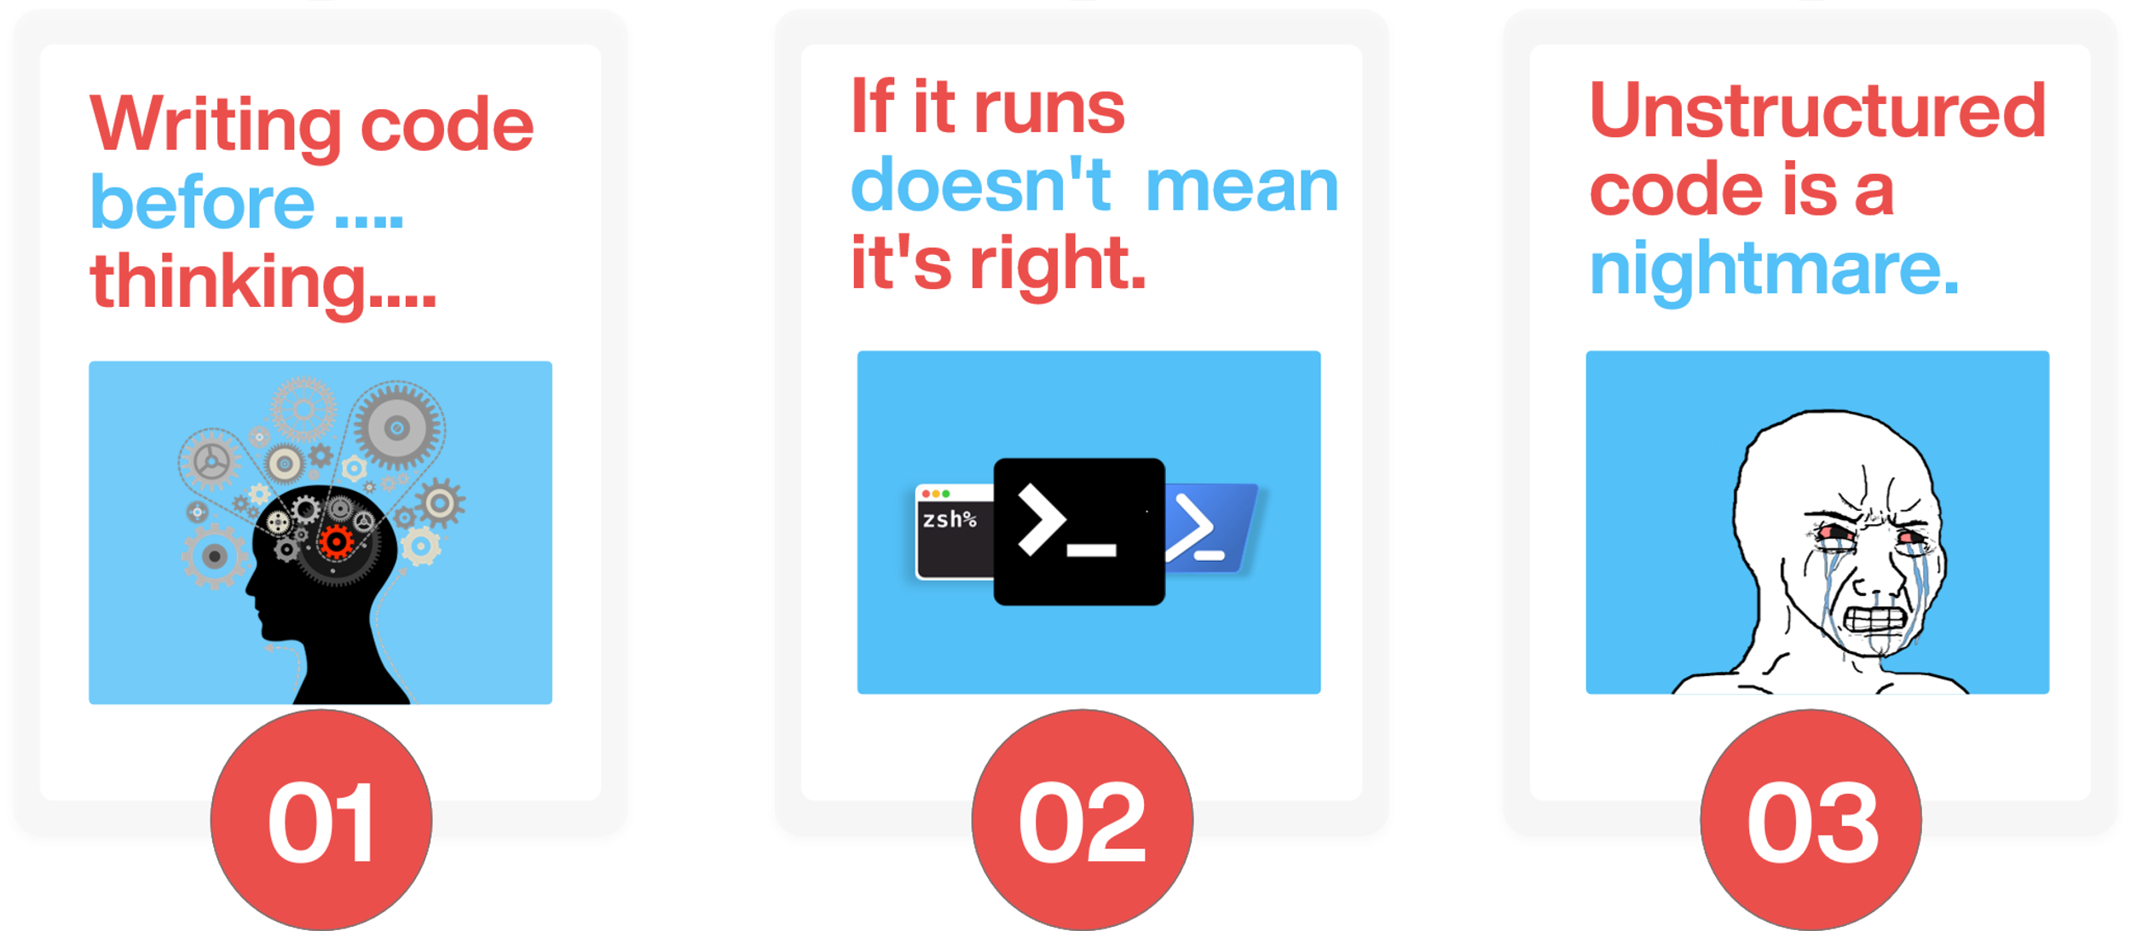
STOP MAKING THESE MISTAKES RIGHT NOW

Slide 5

Average programmer
“ What Happened to him? Professor “
He was trying to debug code.

Slide 6
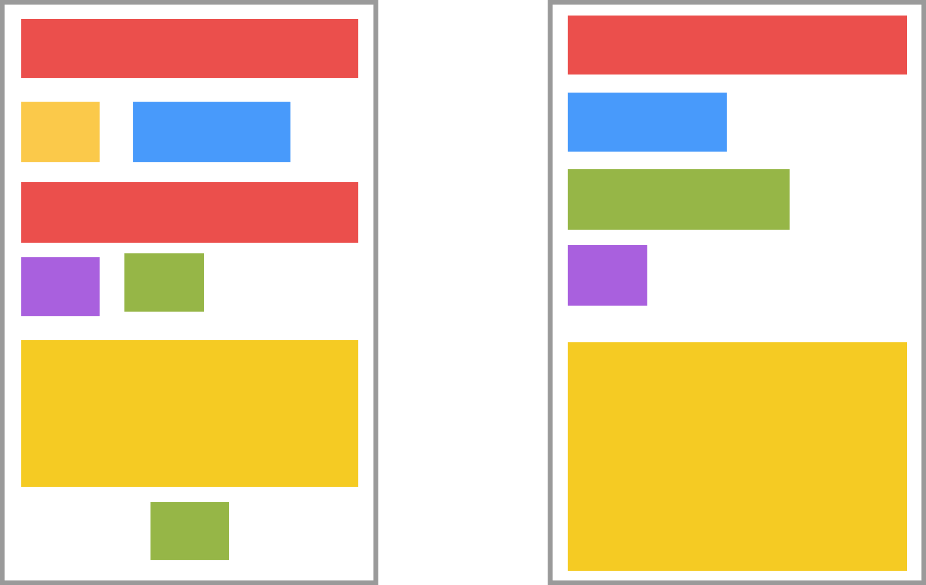
WHICH LOOKS MORE CLEANER?
A
B

Slide 7
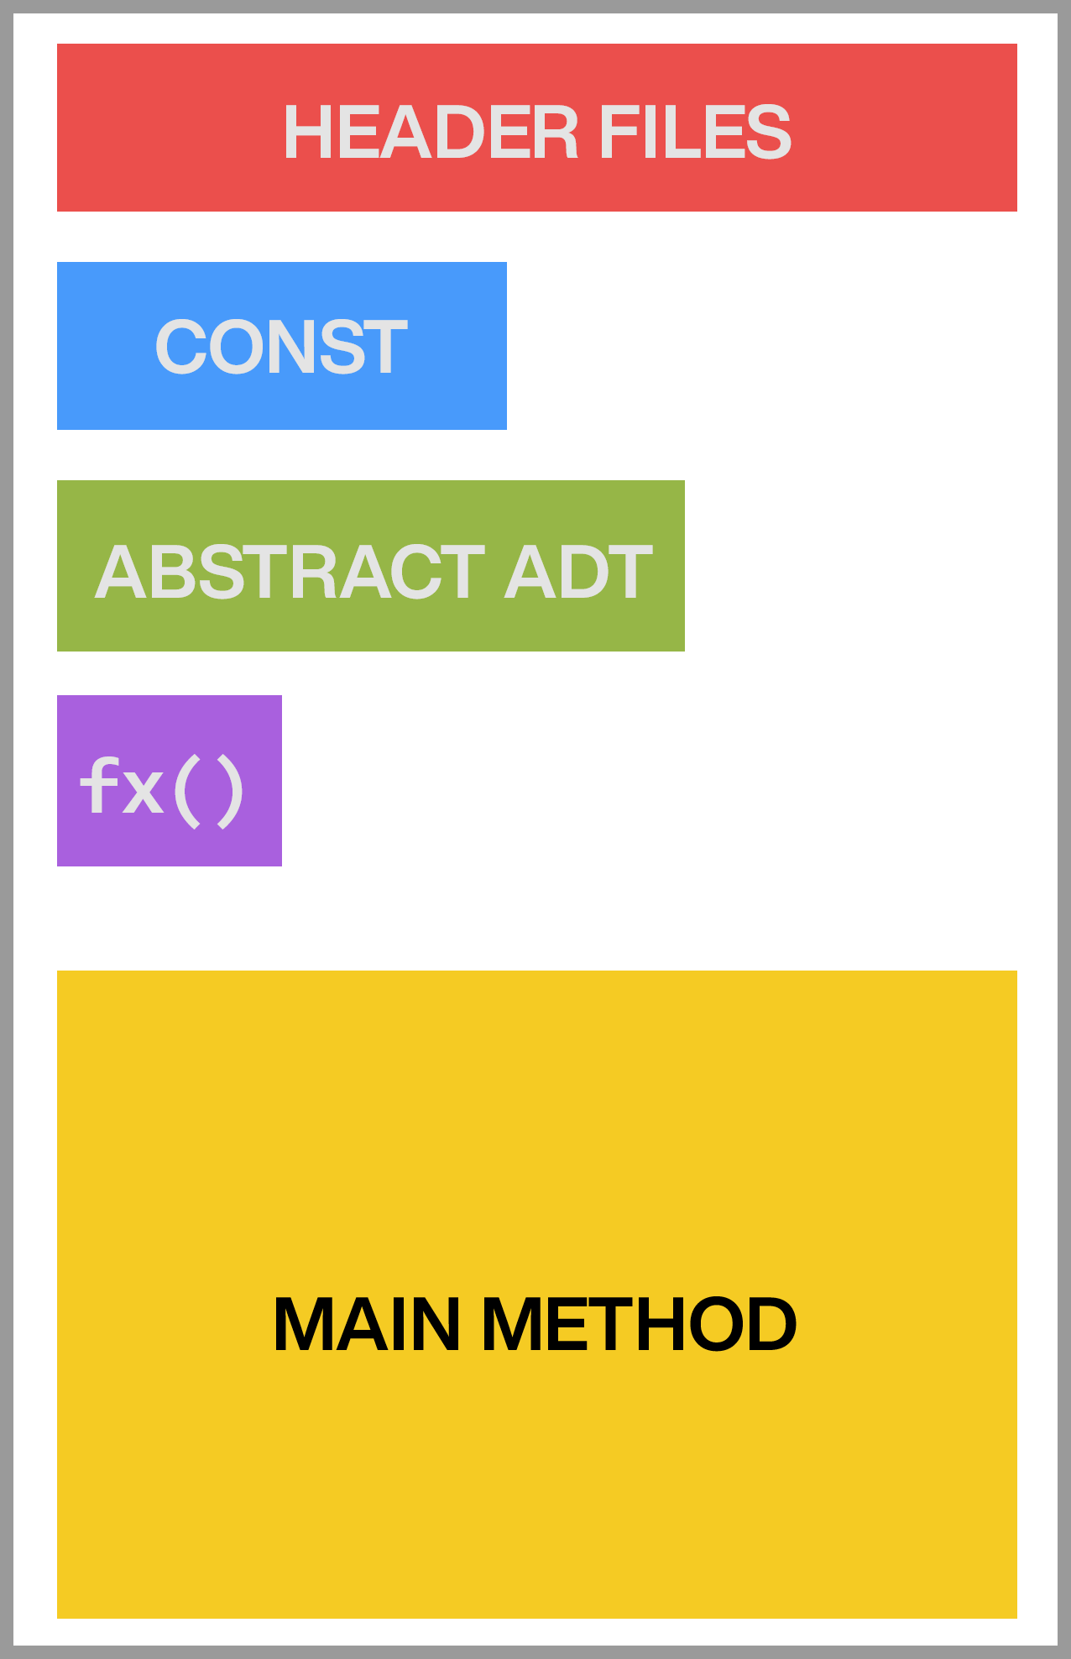
Write More
Structured Code
Easy to debug.
Easy to maintain.
More readable.
Gives resuability.

Slide 8
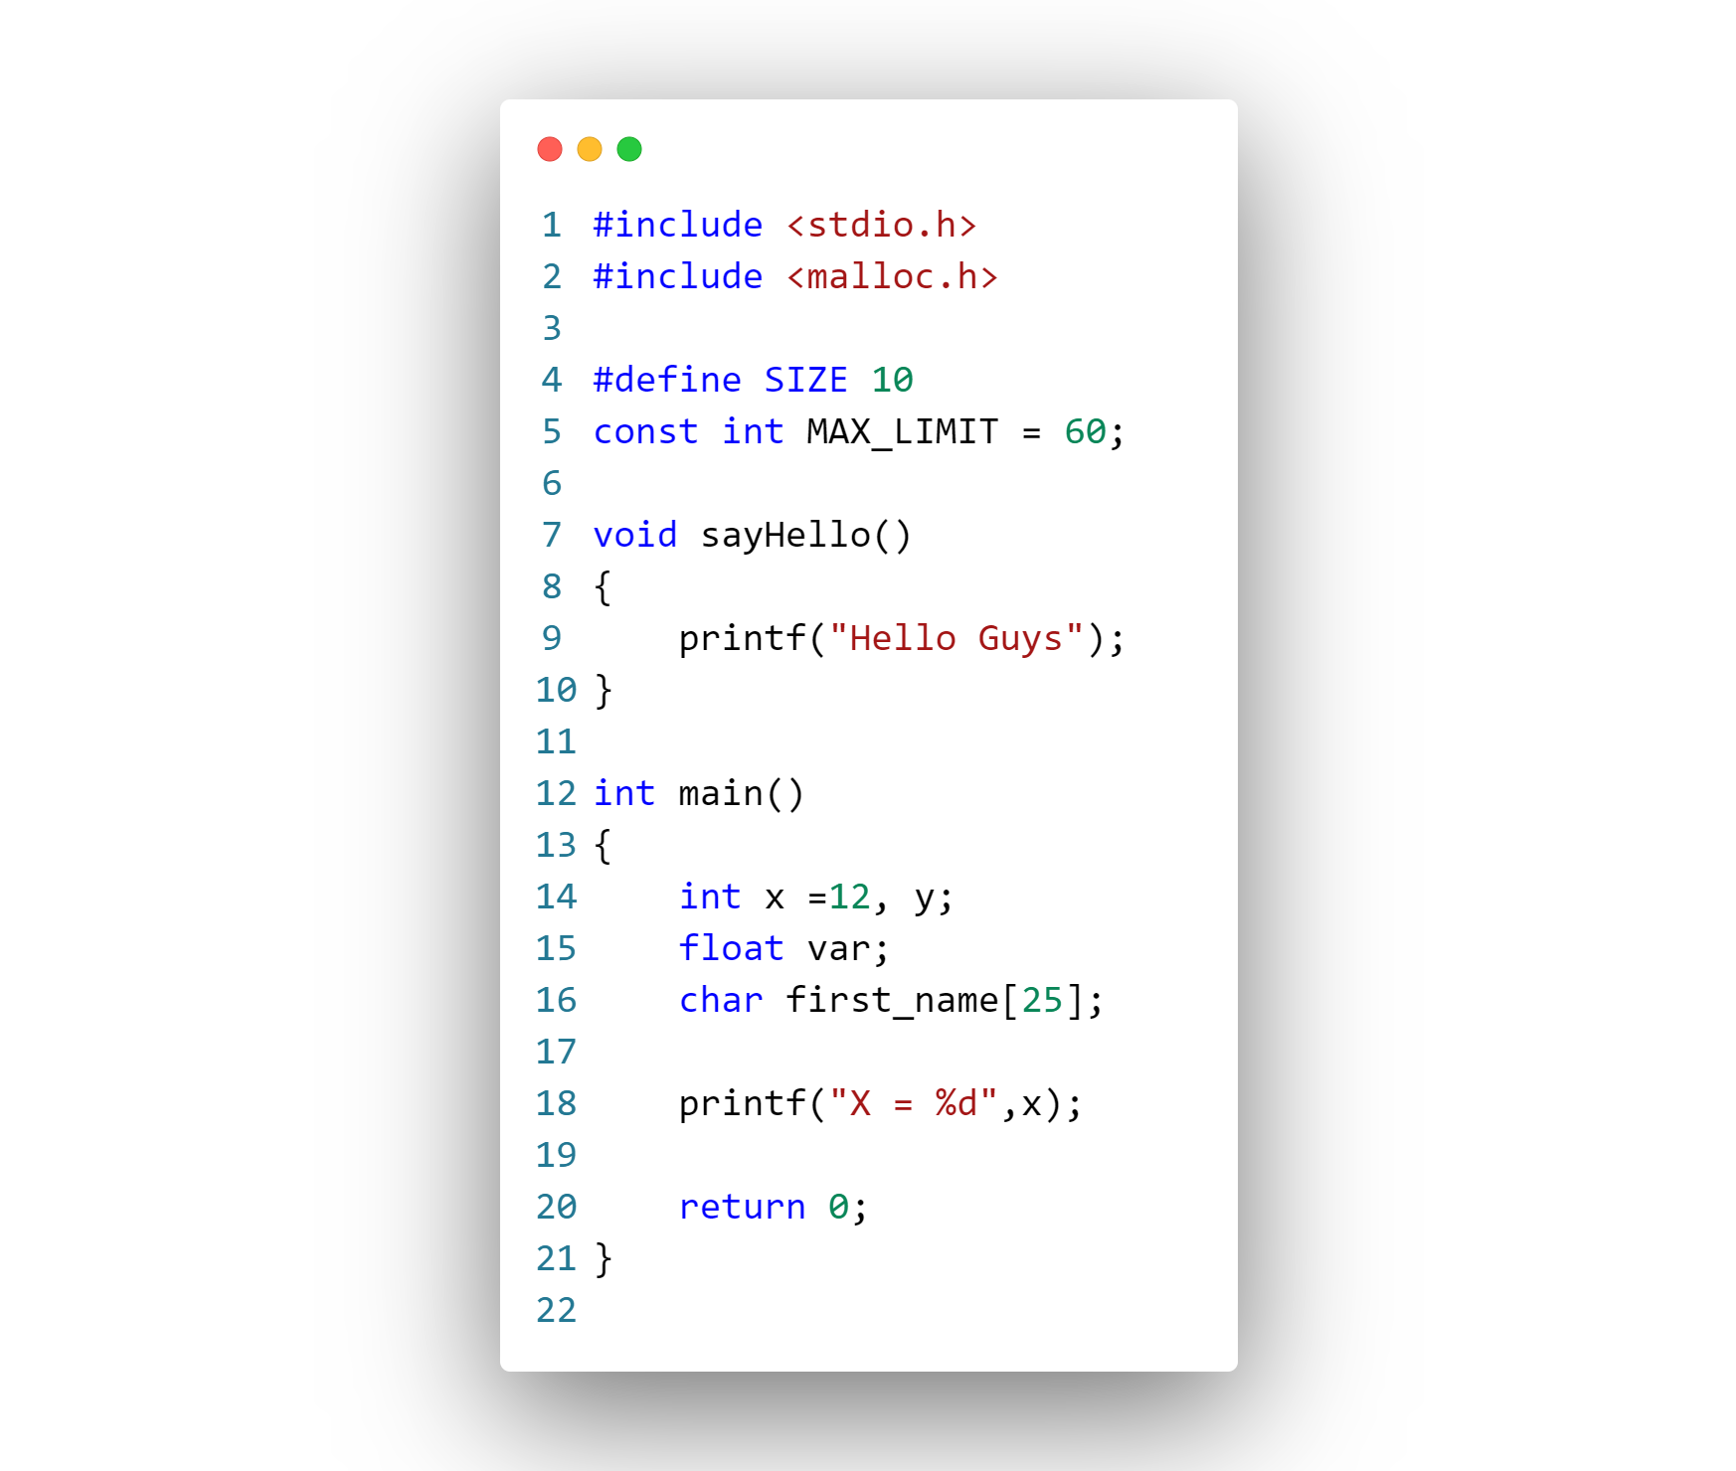
STRUCTURED CODE
Header Files
Constants and Macros
Functions / Structures
Main() method
Driver
Code

Slide 9

NAMING
CONVENTIONS IN C
AN ELEGANT WAY TO WRITE YOUR CODE

Slide 10
NAMING CONVENTIONS
camelCase : used with the functions & member functions.
PascalCase : used with structures and Classes.
UPPER_CASE : used with constants and macros
lower_case : used with variables.

Slide 11
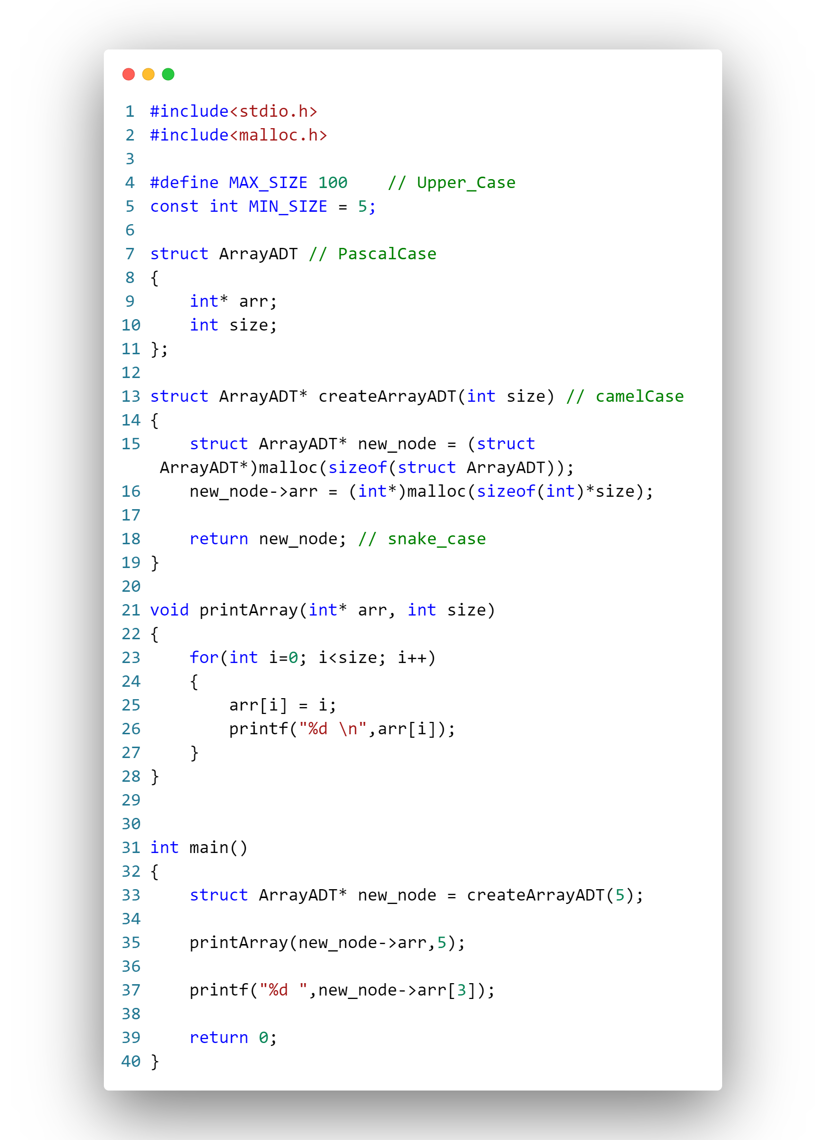

Slide 12


The code inside the header files get pasted into source file during compilation process.

